Slide 1
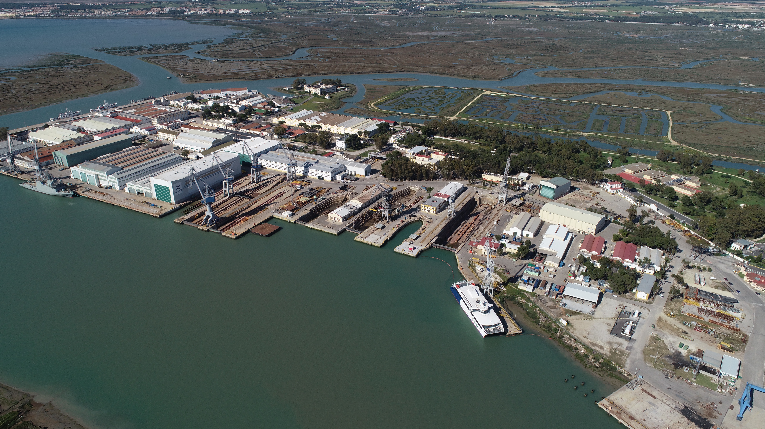
San Fernando Shipyard
Spring equipment: 775 m.
Maximum lifting capacity: 200 Tm.
Stands: 3 stands (136 m x 18 m), (136 m x 21 m), (136 m x 23 m)
Cranes and gantry:
1 gantry crane of 400 Tm.
4 cranes (1 of 120 Tm and 3 of 50 Tm)
Manufacturing area: 27,693 m²
Steel workshop: 4.100 m2
Pre-fabrication: 5,824 m2
Pre-assembly: 7,000 m2
Tubes workshop: 1,700 m2
Module workshop: 2,700 m2
Electricity workshop: 790 m2
Plastic workshop: 4,422 m2
Auxiliary warehouse: 457 m2
Paint booths: 700 m2
Total area: 226.000 m m²

